Slide 1

A Primer to Complex Diseases
National Institute of Technology Karnataka, Surathkal
A seminar by
Venkatesh. S (Roll No.:176PH023)
2nd M.Sc. Physics
(As part of seminar course PH893 during Odd Semester, 2018)
Notes:
Intro slide

Slide 2
Contents
What is a Complex disease?
What is a Complex system?
Properties of Complex systems
What is a Complex disease?
Complex disease as a Complex System
How to study Complex diseases?
A general statement of the problem
A Physics problem – The Ising model
Combinatorial optimization requires Graphs
The answer – Complex Networks
What can we aim to study with Complex Networks?
Measures that matter
Large scale structure
Dynamics and other behaviour

Slide 3
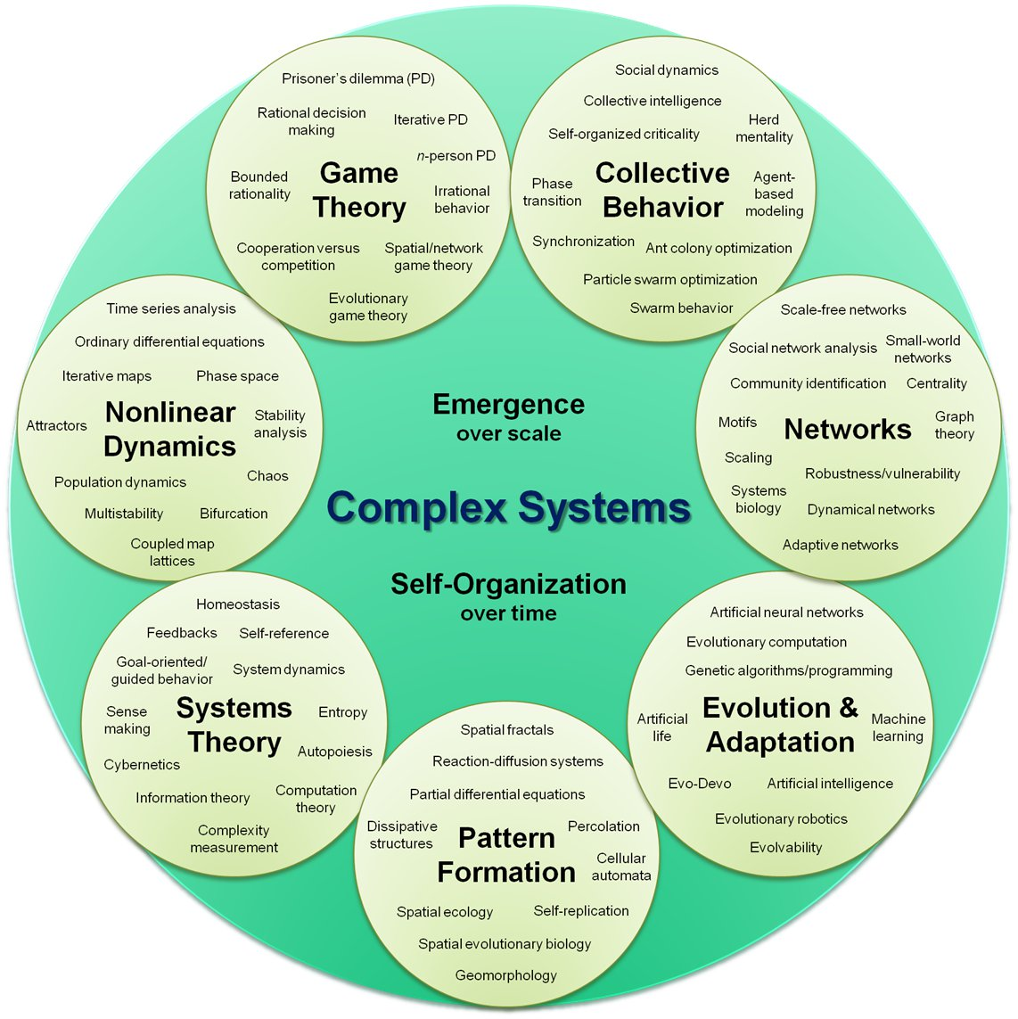
What is a Complex System?
“Complex systems are networks made of a number of components that interact with each other, typically in a nonlinear fashion. Complex systems may arise and evolve through self-organization, such that they are neither completely regular nor completely random, permitting the development of emergent behaviour at macroscopic scales.”¹
1,2.
Fig 1. Organizational map of Complex systems²

Slide 4
Properties of Complex systems

Slide 5
What is a Complex Disease?

